Slide 1
UNIT 4 -DEADLOCKS

Slide 2
A resource can be a hardware device (e.g., a Blu-ray drive) or a piece of information (e.g., a record in a database).
Preemptable and Nonpreemptable Resources
A preemptable resource is one that can be taken away from the process owning it with no ill effects. Memory is an example of a preemptable resource.
A nonpreemptable resource, in contrast, is one that cannot be taken away from its current owner without potentially causing failure.
Deadlock can be defined formally as follows: A set of processes is deadlocked if each process in the set is waiting for an event that only another process in the set can cause.

Slide 3
Conditions for Resource Deadlocks
Coffman et al. (1971) showed that four conditions must hold for there to be a (resource) deadlock:
1. Mutual exclusion condition. Each resource is either currently assigned to exactly one process or is available.
2. Hold-and-wait condition. Processes currently holding resources that were granted earlier can request new resources.
3. No-preemption condition. Resources previously granted cannot be forcibly taken away from a process. They must be explicitly released by the process holding them.
4. Circular wait condition. There must be a circular list of two or more processes, each of which is waiting for a resource held by the next member of the chain.

Slide 4
Deadlock modelling
The graphs have two kinds of nodes: processes, shown as circles, and resources, shown as squares.
A directed arc from a resource node (square) to a process node (circle) means that the resource has previously been requested by, granted to, and is currently held by that process.
In Fig. 6-3(a), resource R is currently assigned to process A. A directed arc from a process to a resource means that the process is currently blocked waiting for that resource.
In Fig. 6-3(b), process B is waiting for resource S.
In Fig. 6-3(c) we see a deadlock: process C is waiting for resource T, which is currently held by process D. Process D is not about to release resource T because it is waiting for resource U, held by C. Both processes will wait forever. A cycle in the graph means that there is a deadlock involving the processes and resources in the cycle (assuming that there is one resource of each kind). In this example, the cycle is C − T − D − U − C.

Slide 5
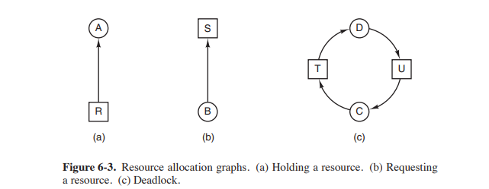

Slide 6
THE OSTRICH ALGORITHM
Mathematicians find it unacceptable and say that deadlocks must be prevented at all costs.
Engineers ask how often the problem is expected, how often the system crashes for other reasons, and how serious a deadlock is.
If deadlocks occur on the average once every five years, but system crashes due to hardware failures and operating system bugs occur once a week, most engineers would not be willing to pay a large penalty in performance or convenience to eliminate deadlocks.
To make this contrast more specific, consider an operating system that blocks the caller when an open system call on a physical device such as a Blu-ray driver or a printer cannot be carried out because the device is busy.
Typically it is up to the device driver to decide what action to take under such circumstances. Blocking or returning an error code are two obvious possibilities. If one process successfully opens the Blu-ray drive and another successfully opens the printer and then each process tries to open the other one and blocks trying, we have a deadlock. Few current systems will detect this.

Slide 7
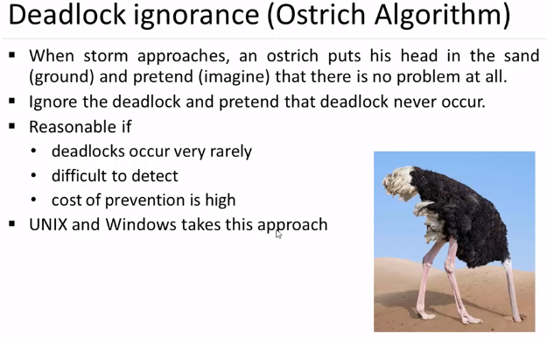

Slide 8
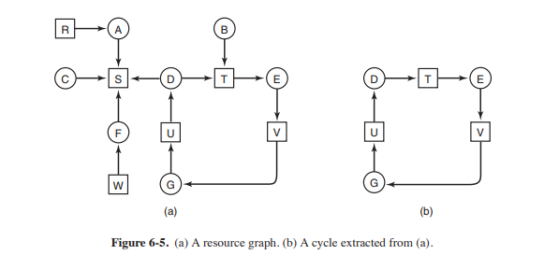
Deadlock Detection with One Resource of Each Type
consider a system with seven processes, A though G, and six resources, R through W.
The state of which resources are currently owned and which ones are currently being requested is as follows:
1. Process A holds R and wants S.
2. Process B holds nothing but wants T.
3. Process C holds nothing but wants S.
4. Process D holds U and wants S and T.
5. Process E holds T and wants V.
6. Process F holds W and wants S.
7. Process G holds V and wants U.

Slide 9
The question is: ‘‘Is this system deadlocked, and if so, which processes are involved?’’
To answer this question, we can construct the resource graph of Fig. 6-5(a).
This graph contains one cycle, which can be seen by visual inspection. The cycle is shown in Fig. 6-5(b).
From this cycle, we can see that processes D, E, and G are all deadlocked.
Processes A, C, and F are not deadlocked because S can be allocated to any one of them, which then finishes and returns it. Then the other two can take it in turn and also complete.

Slide 10
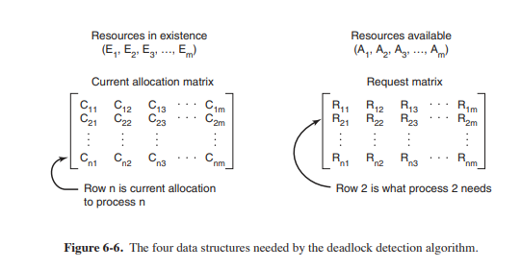
Deadlock Detection with Multiple Resources of Each Type.
When multiple copies of some of the resources exist, matrix-based algorithm for detecting deadlock among n processes, P1 through Pn.
Let the number of resource classes be m, with E1 resources of class 1, E2 resources of class 2, and generally, Ei resources of class i (1 ≤ i ≤ m). E is the existing resource vector. It gives the total number of instances of each resource in existence.
For example, if class 1 is tape drives, then E1 = 2 means the system has two tape drives. At any instant, some of the resources are assigned and are not available.
Let A be the available resource vector, with Ai giving the number of instances of resource i that are currently available (i.e., unassigned).
If both of our two tape drives are assigned, A1 will be 0.
Now we need two arrays, C, the current allocation matrix, and R, the request matrix.
The ith row of C tells how many instances of each resource class Pi currently holds. Thus, Cij is the number of instances of resource j that are held by process i.
Similarly, Rij is the number of instances of resource j that Pi wants.

Slide 11
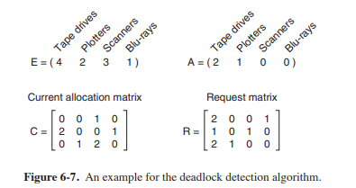
Here we have three processes and four resource classes, which we have arbitrarily labeled tape drives, plotters, scanners, and Blu-ray drives. Process 1 has one scanner. Process 2 has two tape drives and a Blu-ray drive. Process 3 has a plotter and two scanners. Each process needs additional resources, as shown by the R matrix.
The first one cannot be satisfied because there is no Blu-ray drive available. The second cannot be satisfied either, because there is no scanner free. Fortunately, the third one can be satisfied, so process 3 runs and eventually returns all its resources, giving A = (2 2 2 0)
At this point process 2 can run and return its resources, giving A = (4 2 2 1) Now the remaining process can run. There is no deadlock in the system.

Slide 12
Recovery from Deadlock
Recovery through Preemption
In some cases it may be possible to temporarily take a resource away from its current owner and give it to another process.
For example, to take a laser printer away from its owner, the operator can collect all the sheets already printed and put them in a pile. Then the process can be suspended (marked as not runnable). At this point the printer can be assigned to another process. When that process finishes, the pile of printed sheets can be put back in the printer’s output tray and the original process restarted.
The ability to take a resource away from a process, have another process use it, and then give it back without the process noticing it is highly dependent on the nature of the resource.
Choosing the process to suspend depends largely on which ones have resources that can easily be taken back.

Slide 13
Recovery through Rollback
Checkpointing a process means that its state is written to a file so that it can be restarted later.
The checkpoint contains not only the memory image, but also the resource state, in other words, which resources are currently assigned to the process.
To be most effective, new checkpoints should not overwrite old ones but should be written to new files, so as the process executes, a whole sequence accumulates.
When a deadlock is detected, it is easy to see which resources are needed. To do the recovery, a process that owns a needed resource is rolled back to a point in time before it acquired that resource by starting at one of its earlier checkpoints.
All the work done since the checkpoint is lost (e.g., output printed since the checkpoint must be discarded, since it will be printed again).
In effect, the process is reset to an earlier moment when it did not have the resource, which is now assigned to one of the deadlocked processes. If the restarted process tries to acquire the resource again, it will have to wait until it becomes available.

Slide 14
Recovery through Killing Processes
One possibility is to kill a process in the cycle. With a little luck, the other processes will be able to continue. If this does not help, it can be repeated until the cycle is broken.
Alternatively, a process not in the cycle can be chosen as the victim in order to release its resources.
In this approach, the process to be killed is carefully chosen because it is holding resources that some process in the cycle needs.
Example: one process might hold a printer and want a plotter, with another process holding a plotter and wanting a printer. These two are deadlocked. A third process may hold another identical printer and another identical plotter and be happily running. Killing the third process will release these resources and break the deadlock involving the first two. Where possible, it is best to kill a process that can be rerun from the beginning with no ill effects.
For example, a compilation can always be rerun because all it does is read a source file and produce an object file. If it is killed partway through, the first run has no influence on the second run.
On the other hand, a process that updates a database cannot always be run a second time safely. If the process adds 1 to some field of a table in the database, running it once, killing it, and then running it again will add 2 to the field, which is incorrect.

Slide 15
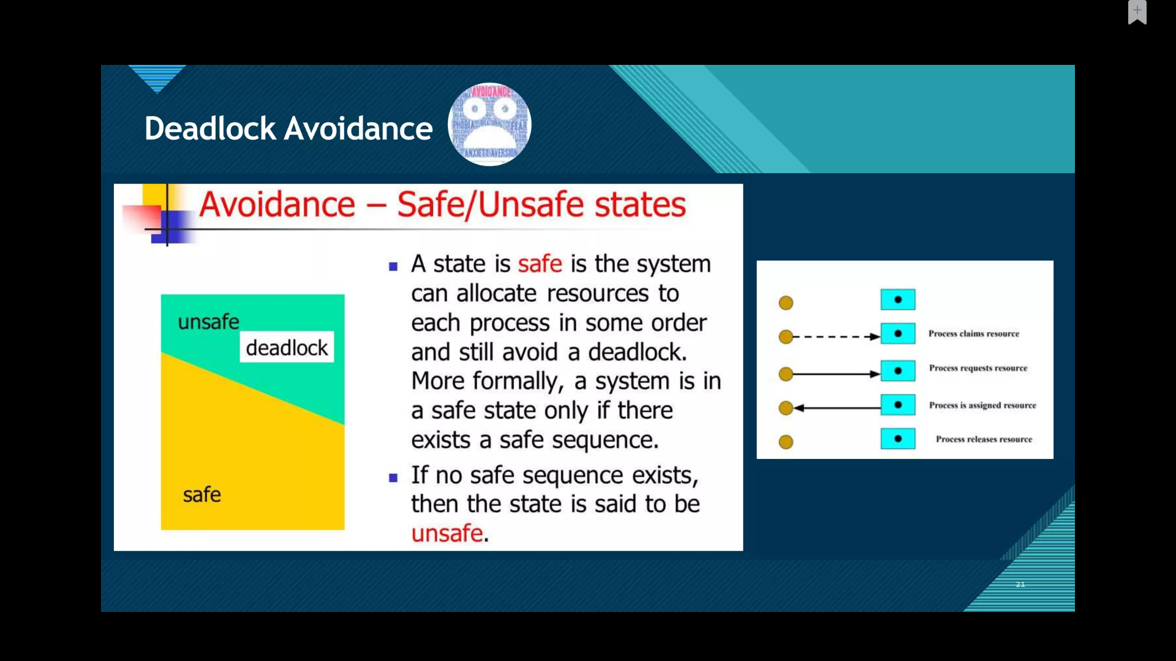

Slide 16
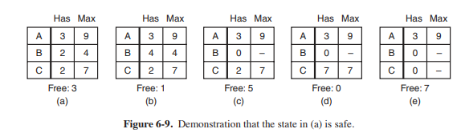
Safe and Unsafe States
In Fig. 6-9(a) we have a state in which A has three instances of the resource but may need as many as nine eventually. B currently has two and may need four altogether, later. Similarly, C also has two but may need an additional five. A total of 10 instances of the resource exist, so with seven resources already allocated, three there are still free.
The state of Fig. 6-9(a) is safe because there exists a sequence of allocations that allows all processes to complete. Namely, the scheduler can simply run B exclusively, until it asks for and gets two more instances of the resource, leading to the state of Fig. 6-9(b). When B completes, we get the state of Fig. 6-9(c). Then the scheduler can run C, leading eventually to Fig. 6-9(d). When C completes, we get Fig. 6-9(e). Now A can get the six instances of the resource it needs and also complete.

Slide 17
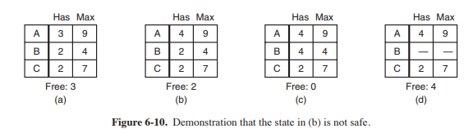
Now suppose we have the initial state shown in Fig. 6-10(a), but this time A requests and gets another resource, giving Fig. 6-10(b). Can we find a sequence that is guaranteed to work? Let us try. The scheduler could run B until it asked for all its resources, as shown in Fig. 6-10(c). Eventually, B completes and we get the state of Fig. 6-10(d). At this point we are stuck.
We only have four instances of the resource free, and each of the active processes needs five. There is no sequence that guarantees completion. Thus, the allocation decision that moved the system from Fig. 6-10(a) to Fig. 6-10(b) went from a safe to an unsafe state. Running A or C next starting at Fig. 6-10(b) does not work either. In retrospect, A’s request should not have been granted. It is worth noting that an unsafe state is not a deadlocked state.
Thus, the difference between a safe state and an unsafe state is that from a safe state the system can guarantee that all processes will finish; from an unsafe state, no such guarantee can be given

Slide 18
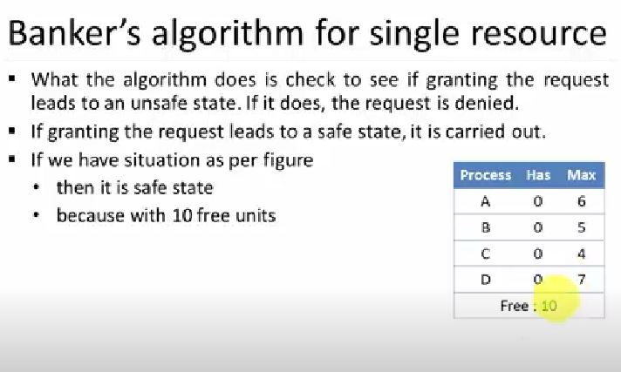
Deadlock avoidance

Slide 19
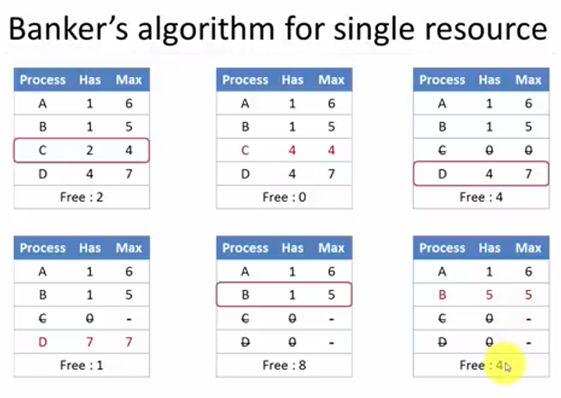
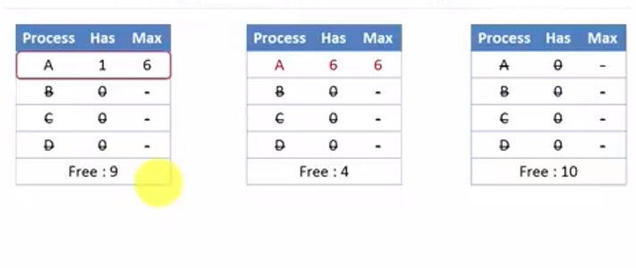

Slide 20
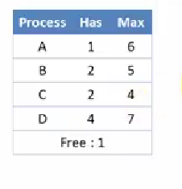

Slide 21
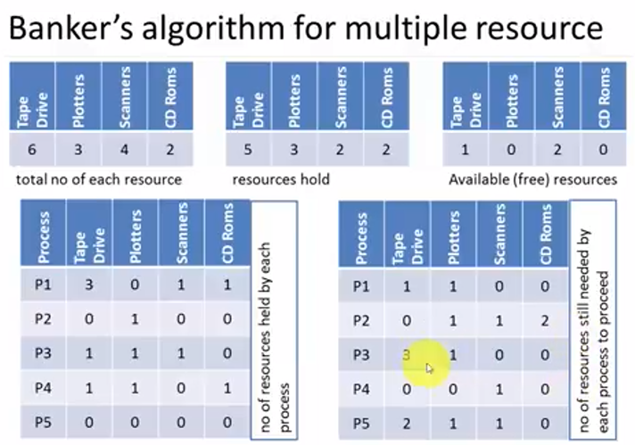
Solve

Slide 22
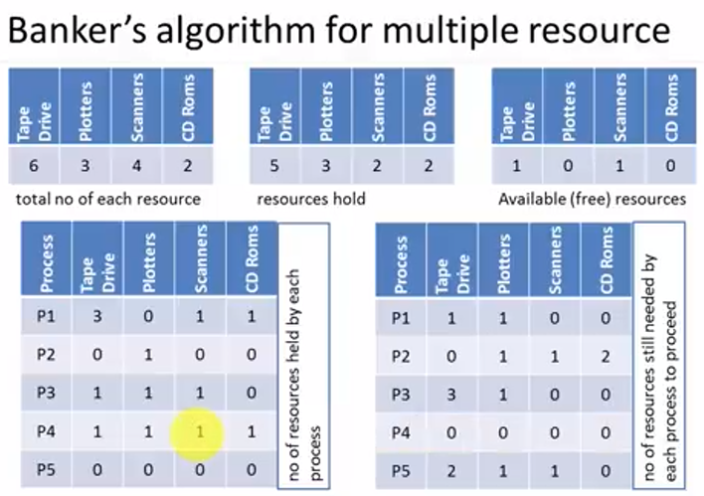
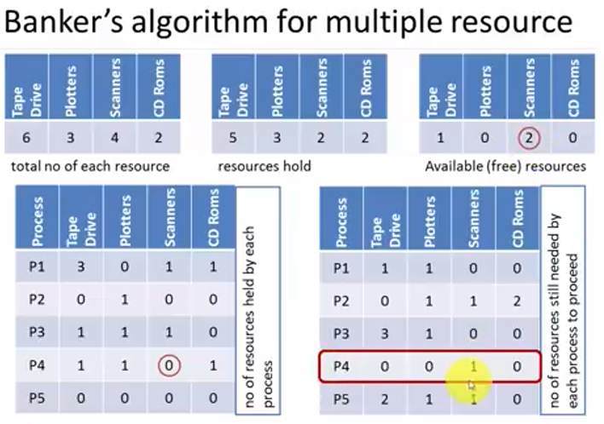

Slide 23
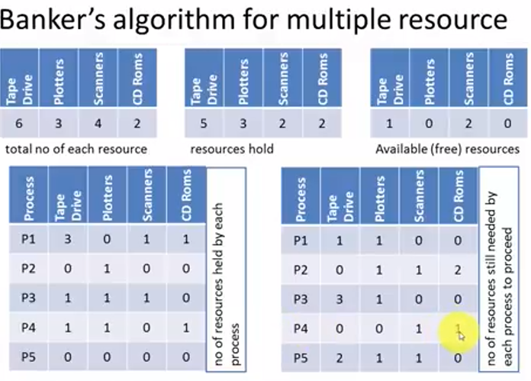

Slide 24
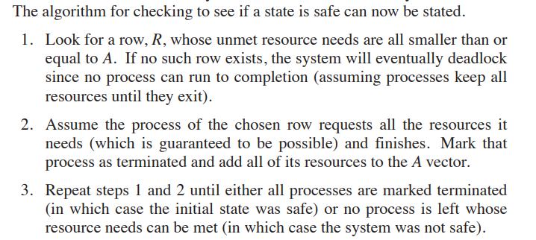

Slide 25
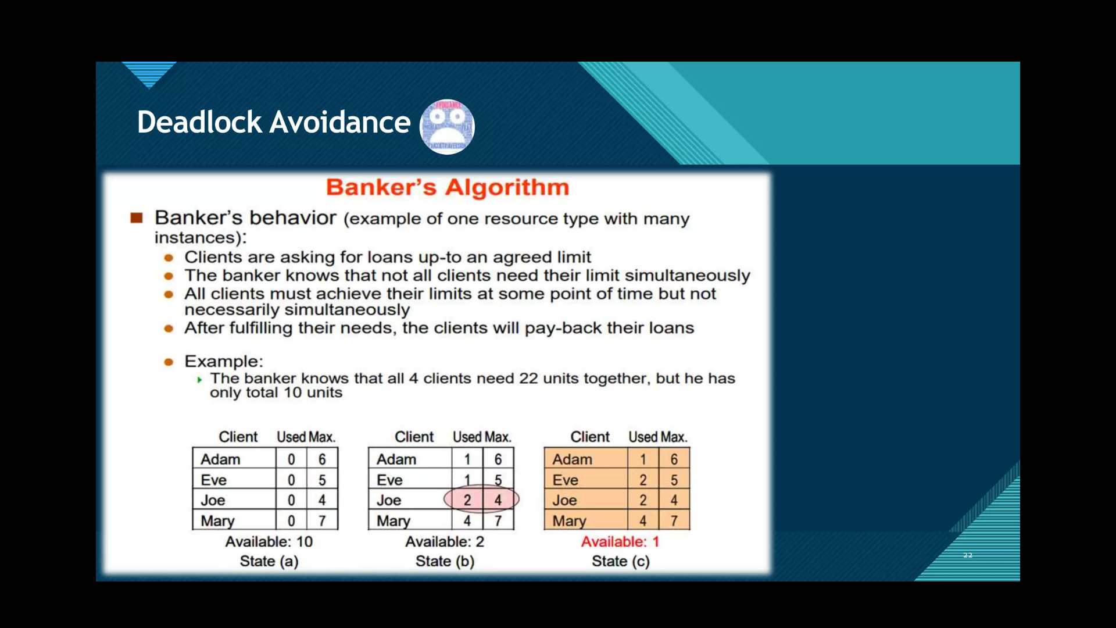

Slide 26
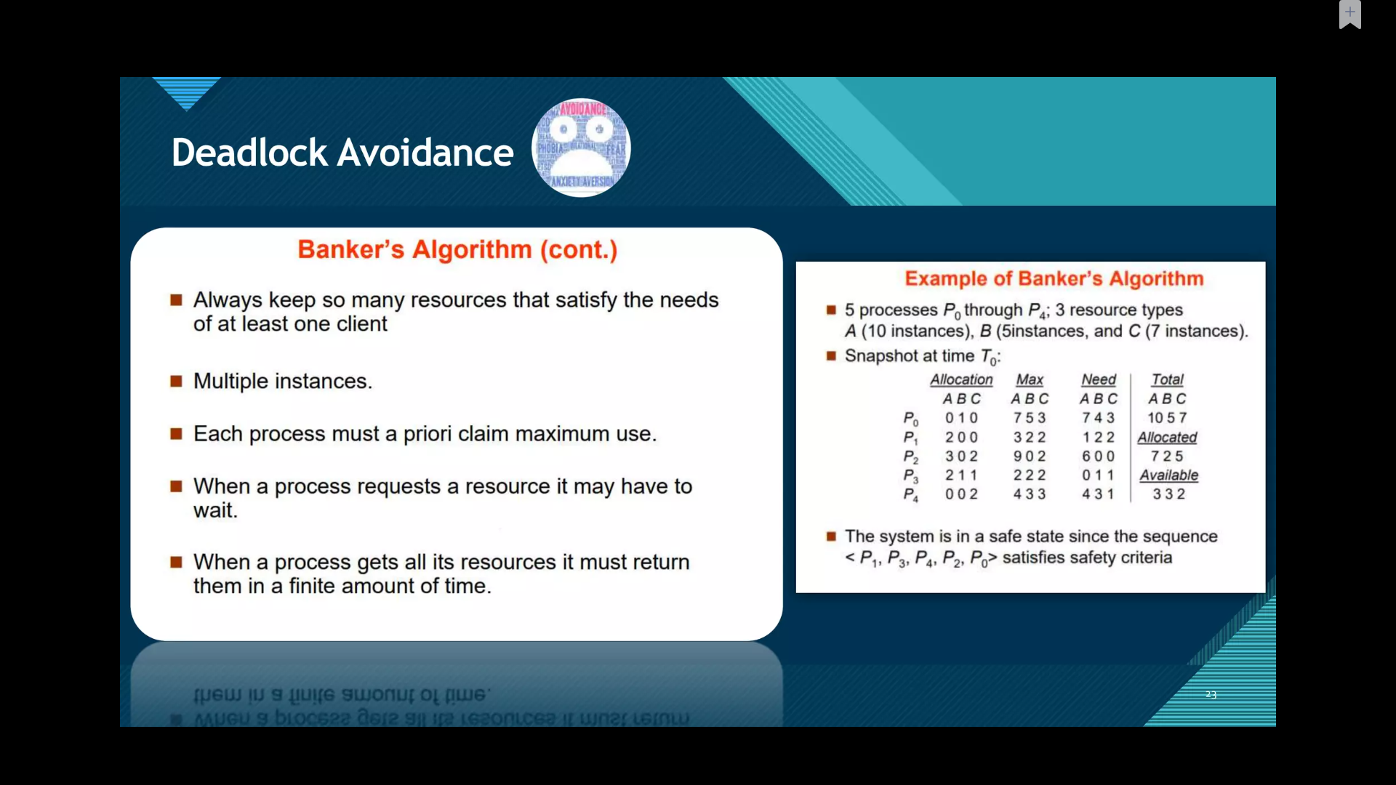

Slide 27
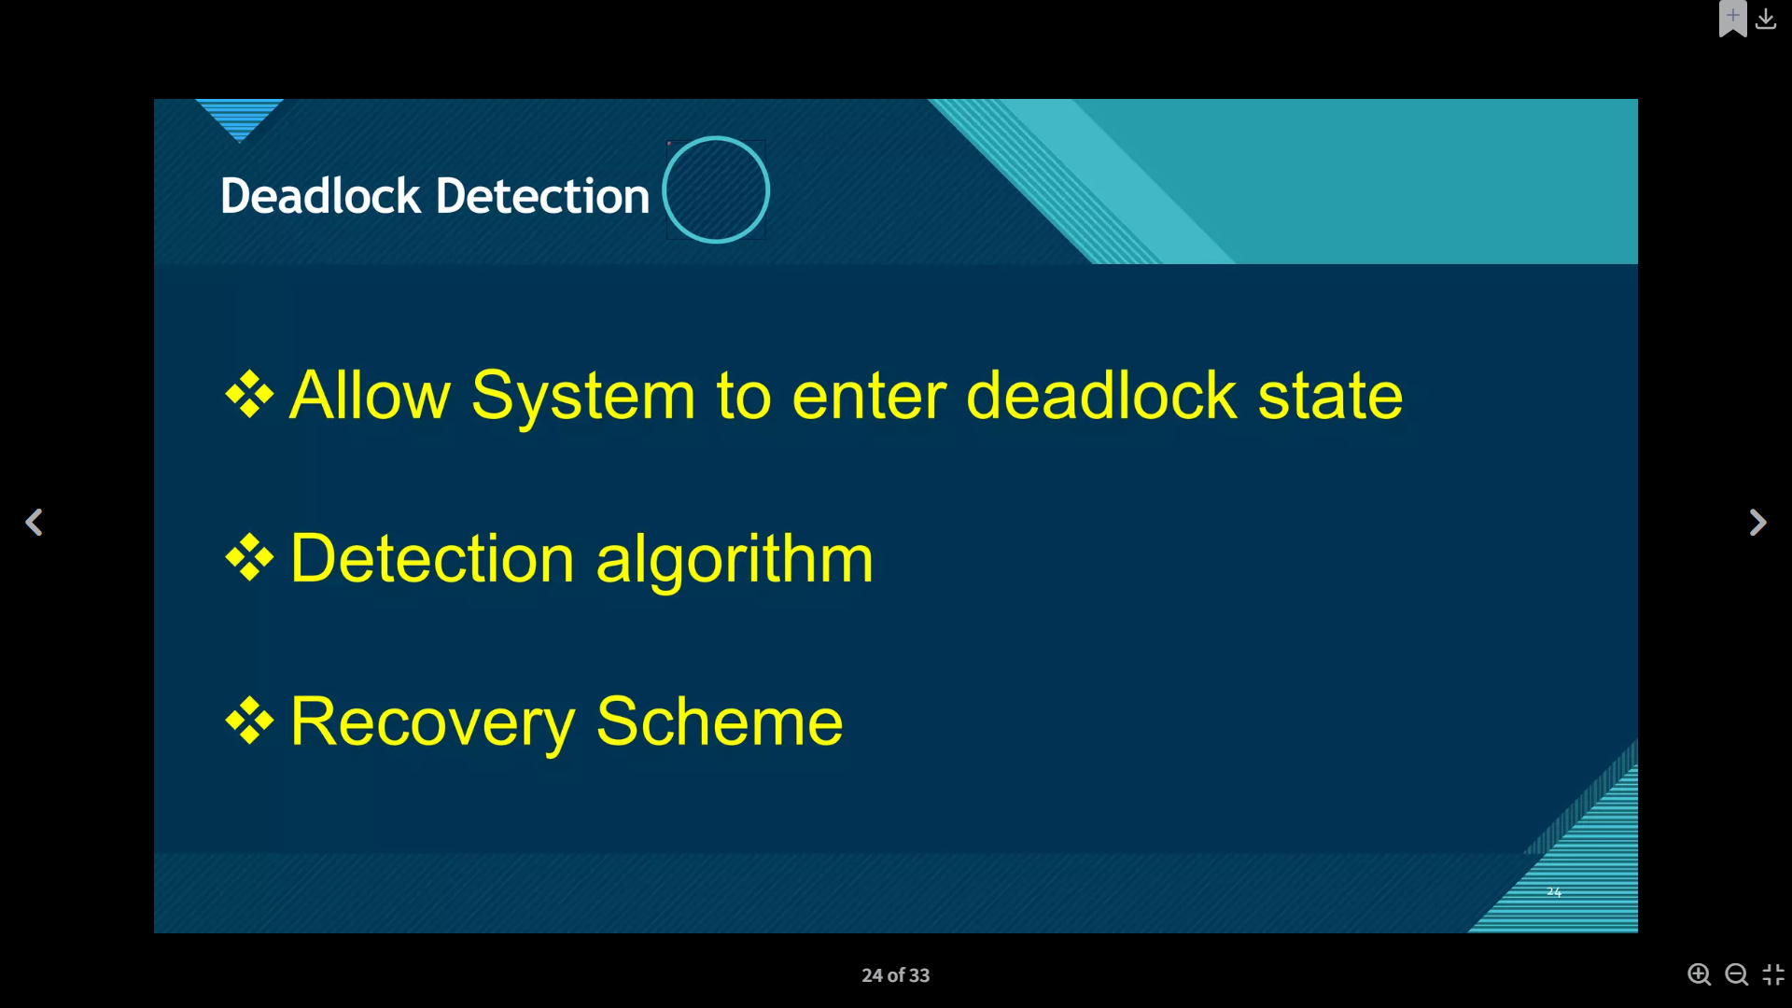

Slide 28
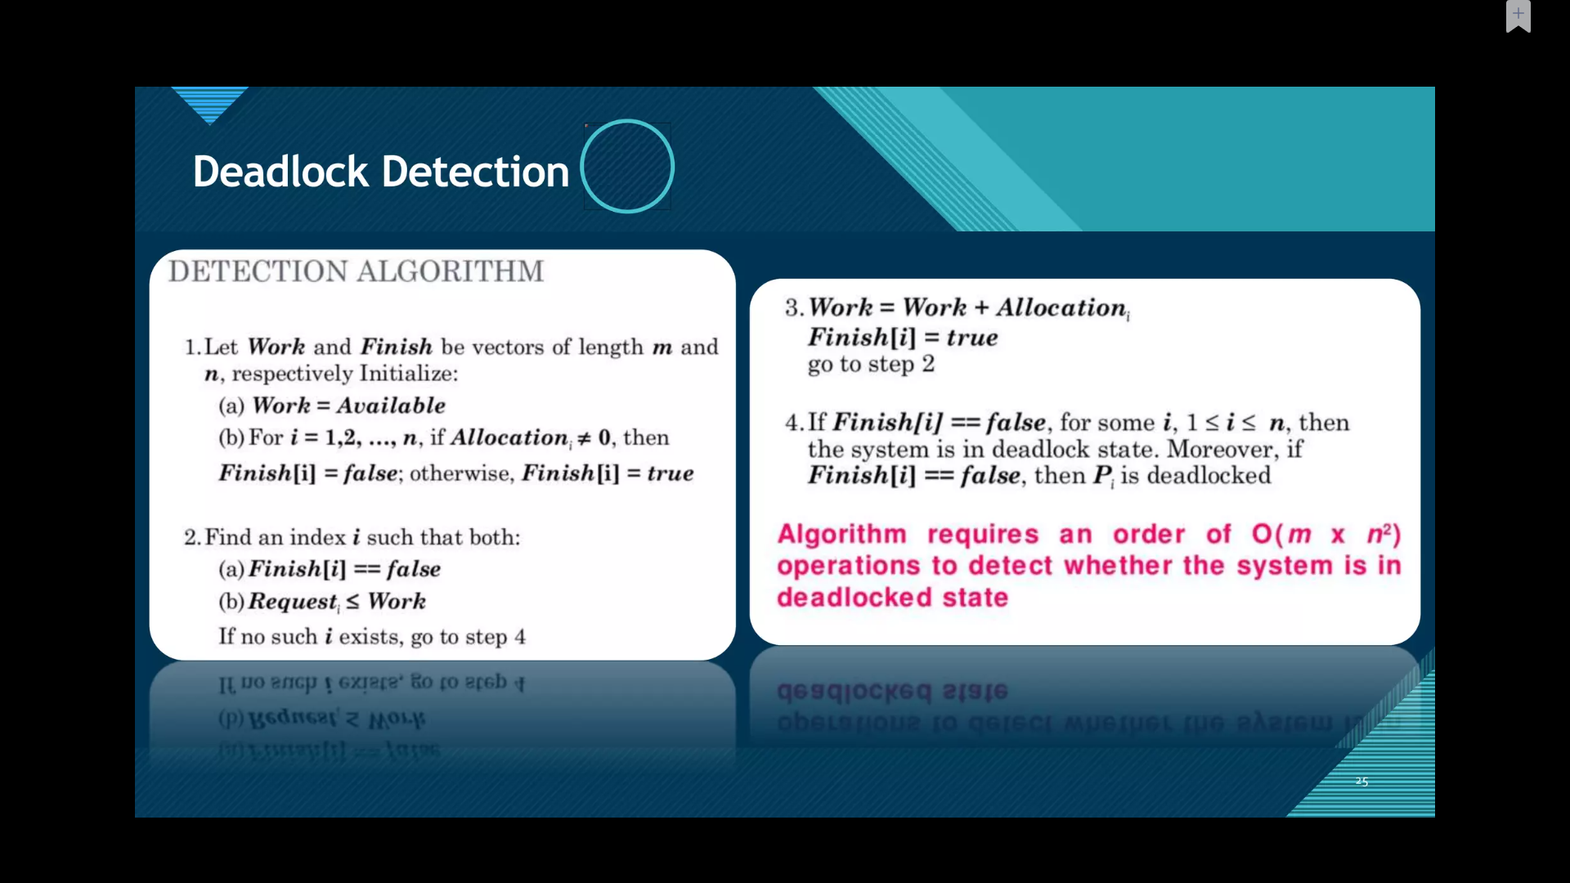

Slide 29
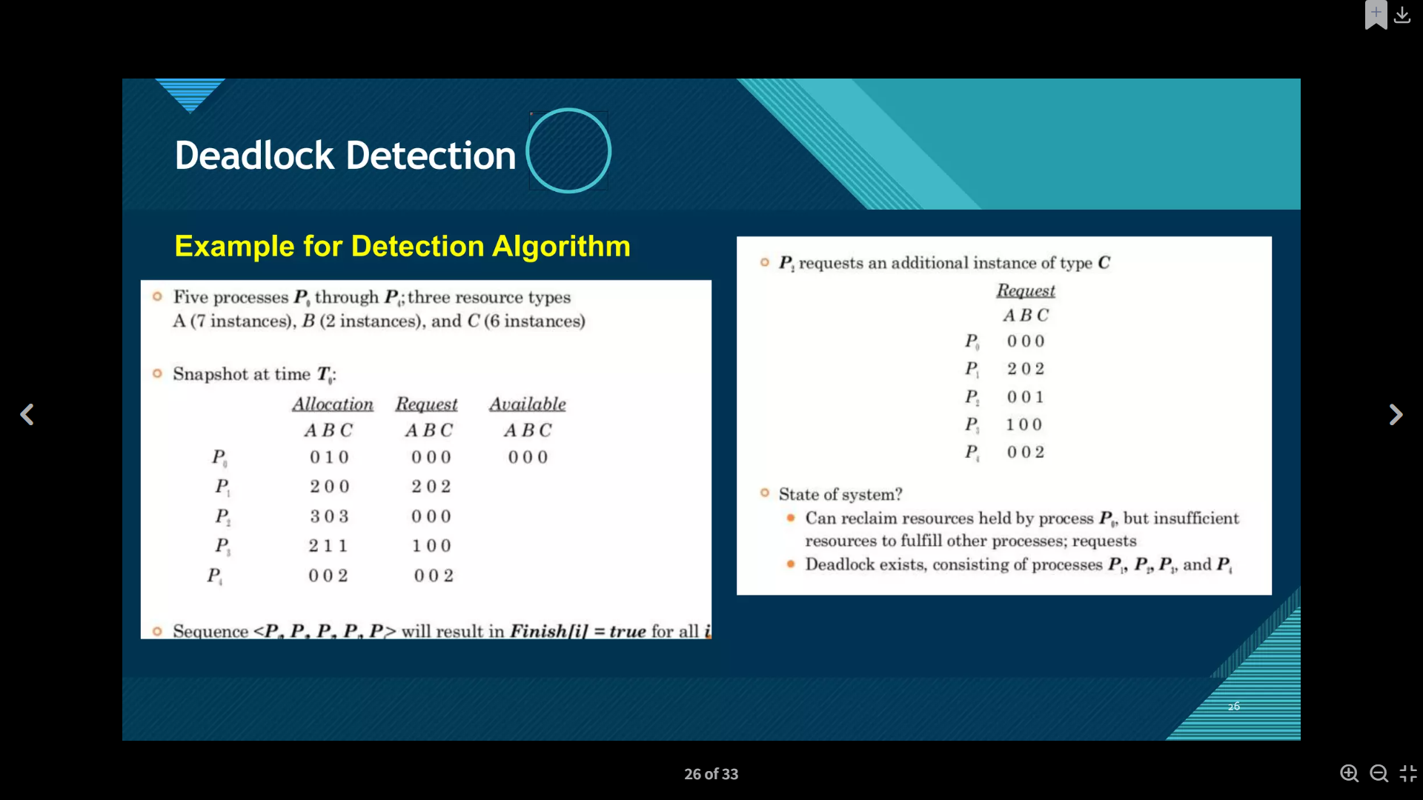

Slide 30
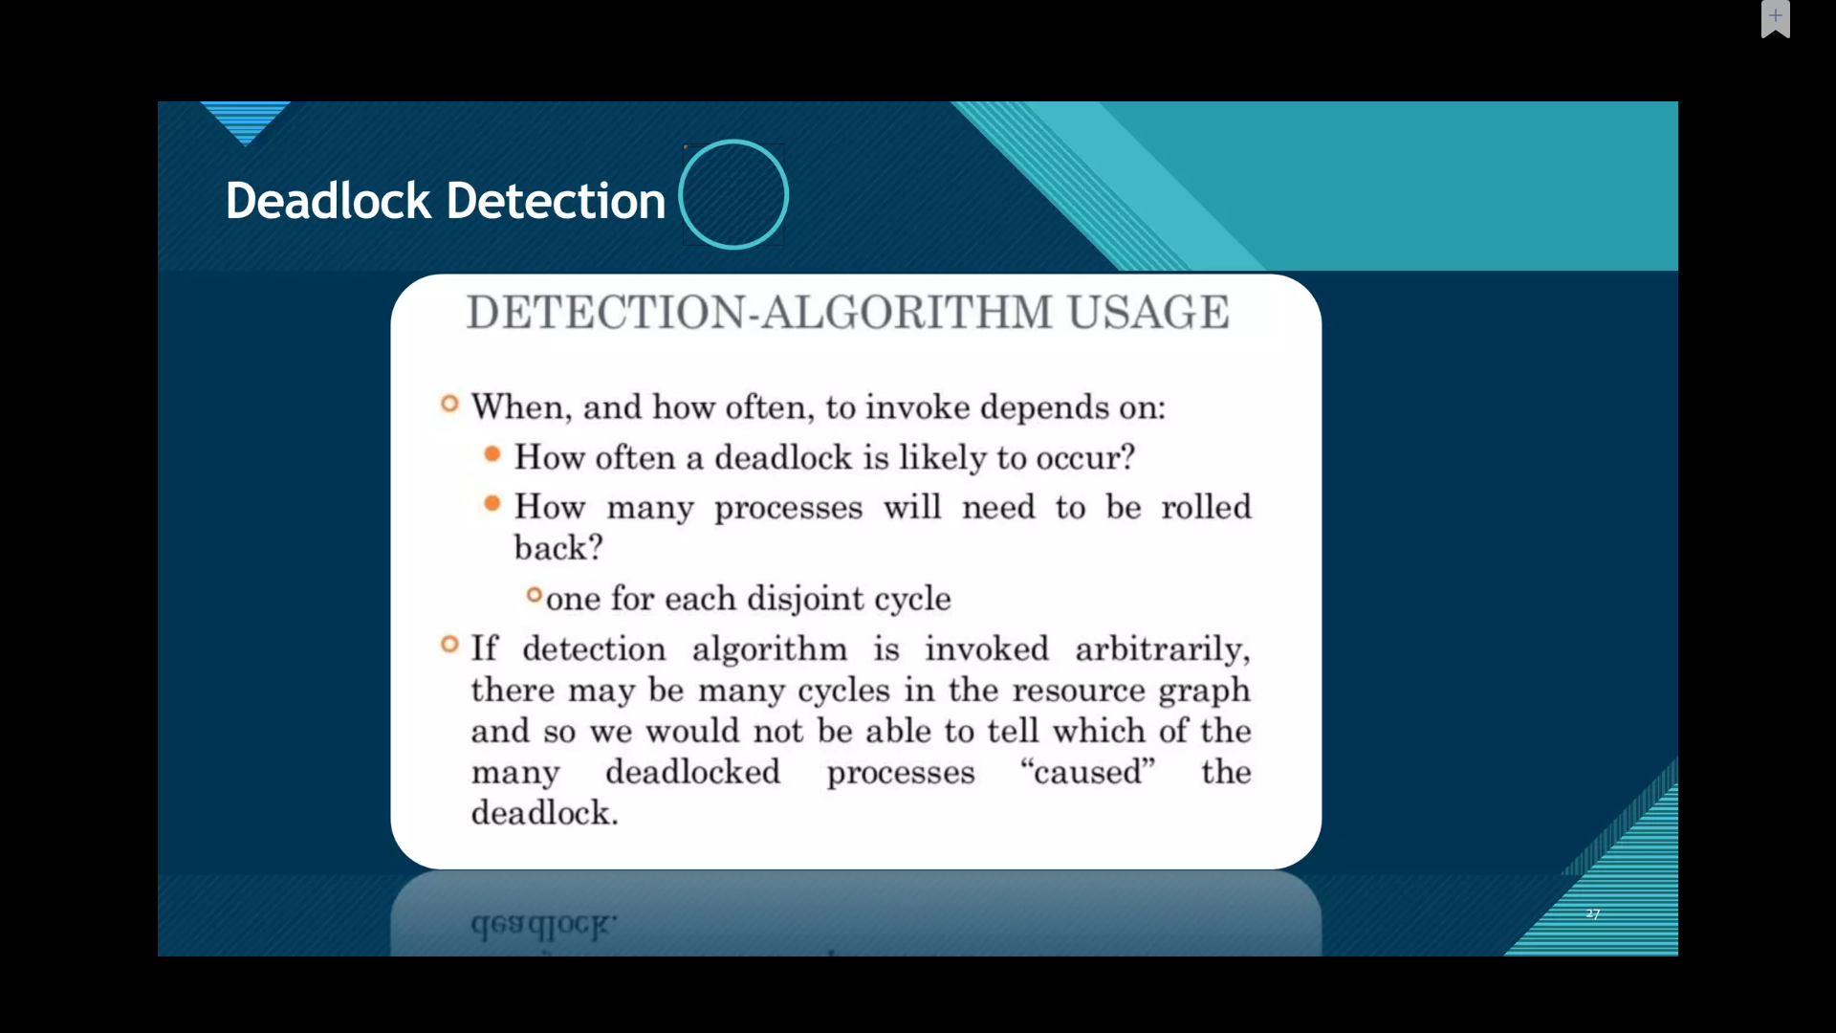

Slide 31
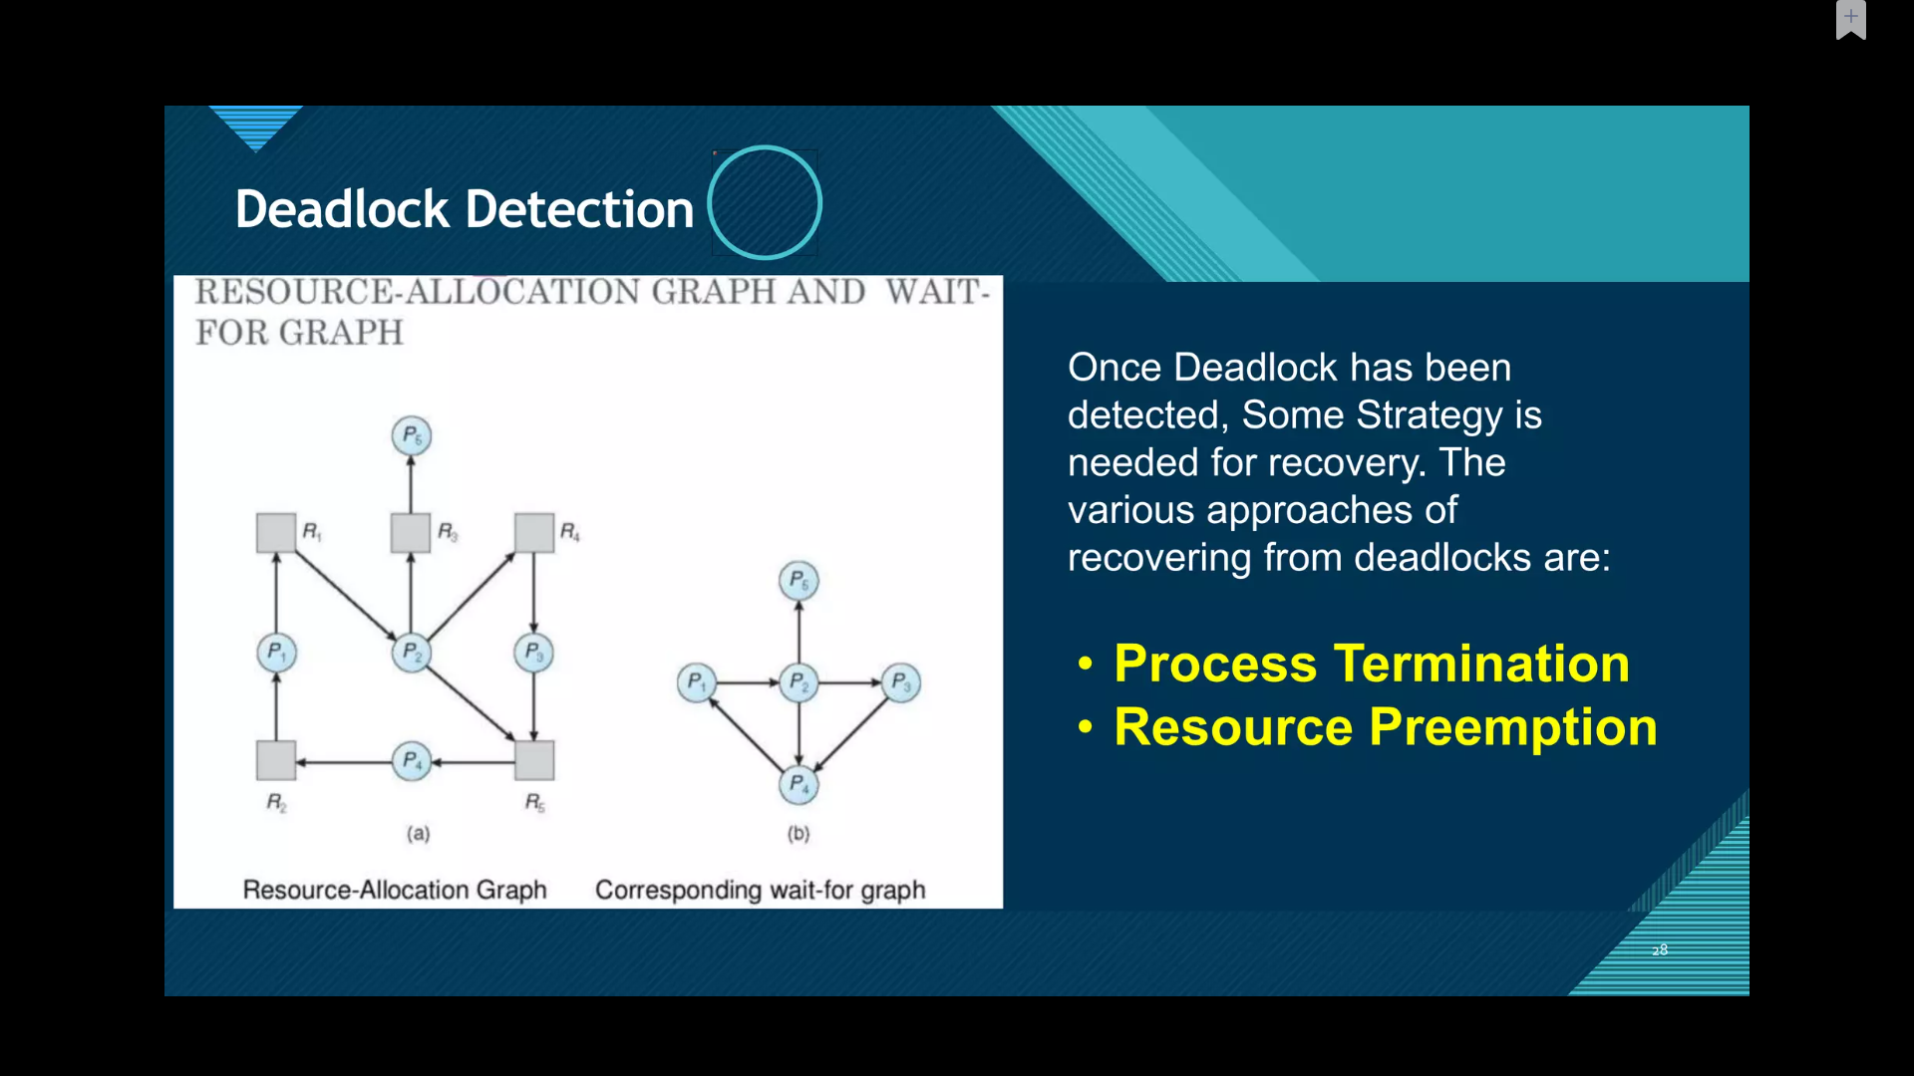

Slide 32
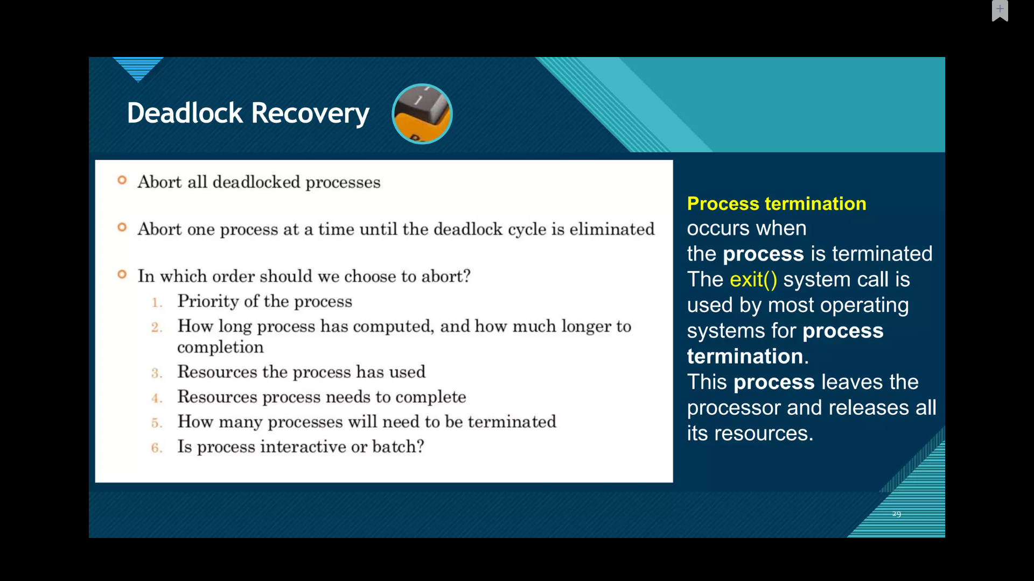

Slide 33
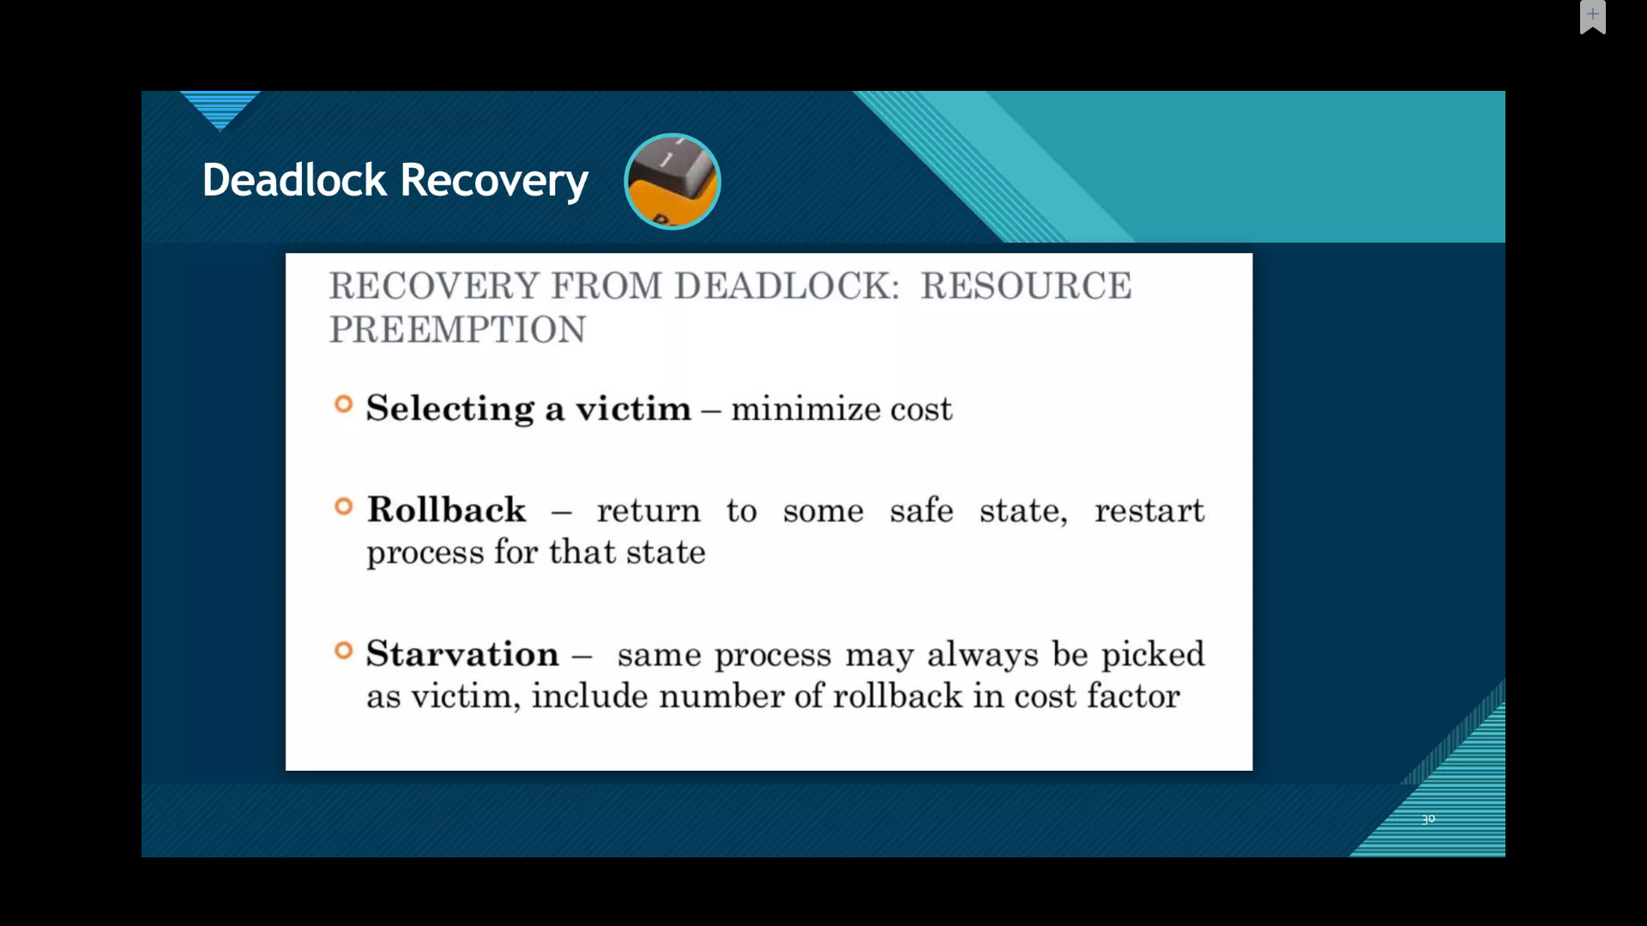

Slide 34
DEADLOCK PREVENTION
Attacking the Mutual-Exclusion Condition
If no resource were ever assigned exclusively to a single process, we would never have deadlocks. For data, the simplest method is to make data read only, so that processes can use the data concurrently.
However, it is equally clear that allowing two processes to write on the printer at the same time will lead to chaos. By spooling printer output, several processes can generate output at the same time.
In this model, the only process that actually requests the physical printer is the printer daemon. Since the daemon never requests any other resources, we can eliminate deadlock for the printer.
If the daemon is programmed to begin printing even before all the output is spooled, the printer might lie idle if an output process decides to wait several hours after the first burst of output. For this reason, daemons are normally programmed to print only after the complete output file is available. However, this decision itself could lead to deadlock.
What would happen if two processes each filled up one half of the available spooling space with output and neither was finished producing its full output? In this case, we would have two processes that had each finished part, but not all, of their output, and could not continue. Neither process will ever finish, so we would have a deadlock on the disk.
Avoid assigning a resource unless absolutely necessary, and try to make sure that as few processes as possible may actually claim the resource.

Slide 35
Attacking the Hold-and-Wait Condition
One way to achieve this goal is to require all processes to request all their resources before starting execution.
If everything is available, the process will be allocated whatever it needs and can run to completion. If one or more resources are busy, nothing will be allocated and the process will just wait.
An immediate problem with this approach is that many processes do not know how many resources they will need until they have started running.
In fact, if they knew, the banker’s algorithm could be used. Another problem is that resources will not be used optimally with this approach. Take, as an example, a process that reads data from an input tape, analyzes it for an hour, and then writes an output tape as well as plotting the results. If all resources must be requested in advance, the process will tie up the output tape drive and the plotter for an hour.
The system then preallocates all resources immediately and does not release them until they are no longer needed by the job. While this method puts a burden on the programmer and wastes resources, it does prevent deadlocks.
A slightly different way to break the hold-and-wait condition is to require a process requesting a resource to first temporarily release all the resources it currently holds. Then it tries to get everything it needs all at once.

Slide 36
Attacking the No-Preemption Condition
If a process has been assigned the printer and is in the middle of printing its output, forcibly taking away the printer because a needed plotter is not available is tricky at best and impossible at worst. However, some resources can be virtualized to avoid this situation.
Spooling printer output to the disk and allowing only the printer daemon access to the real printer eliminates deadlocks involving the printer, although it creates a potential for deadlock over disk space. With large disks though, running out of disk space is unlikely.
However, not all resources can be virtualized like this.
For example, records in databases or tables inside the operating system must be locked to be used and therein lies the potential for deadlock.

Slide 37
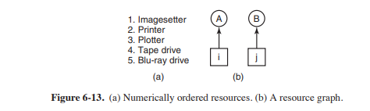
Attacking the Circular Wait Condition
One way is simply to have a rule saying that a process is entitled only to a single resource at any moment. If it needs a second one, it must release the first one. For a process that needs to copy a huge file from a tape to a printer, this restriction is unacceptable.
Another way to avoid the circular wait is to provide a global numbering of all the resources, as shown in Fig. 6-13(a). Now the rule is this: processes can request resources whenever they want to, but all requests must be made in numerical order. A process may request first a printer and then a tape drive, but it may not request first a plotter and then a printer. With this rule, the resource allocation graph can never have cycles.
Let us see why this is true for the case of two processes, in Fig. 6-13(b). We can get a deadlock only if A requests resource j and B requests resource i. Assuming i and j are distinct resources, they will have different numbers. If i > j, then A is not allowed to request j because that is lower than what it already has. If i < j, then B is not allowed to request i because that is lower than what it already has. Either way, deadlock is impossible.

Slide 38
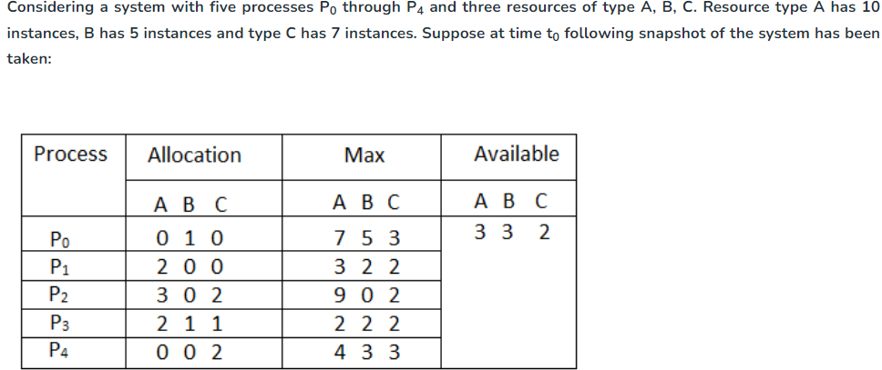
Question1. What will be the content of the Need matrix?
Question2. Is the system in a safe state? If Yes, then what is the safe sequence?

Slide 39
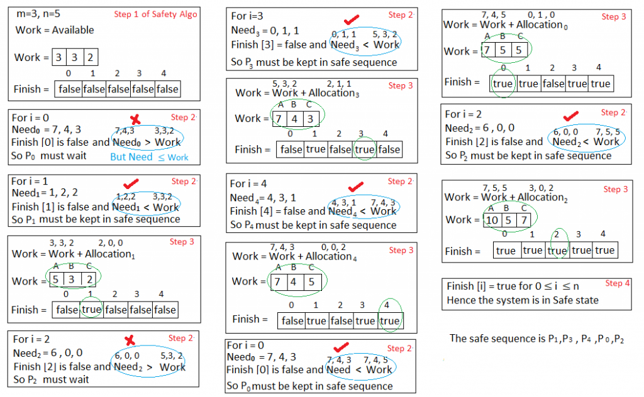

Slide 40
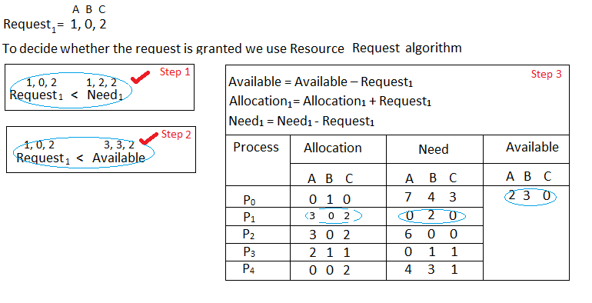
Question3. What will happen if process P₁ requests one additional instance of resource type A and two instances of resource type C?

Slide 41
Two phase locking
When multiple processes are running at the same time, there is a real danger of deadlock.
The approach often used is called two-phase locking. In the first phase, the process tries to lock all the records it needs, one at a time. If it succeeds, it begins the second phase, performing its updates and releasing the locks.
No real work is done in the first phase. If during the first phase, some record is needed that is already locked, the process just releases all its locks and starts the first phase all over.
In a certain sense, this approach is similar to requesting all the resources needed in advance, or at least before anything irreversible is done.

Slide 42
Livelock
Consider an atomic primitive try lock in which the calling process tests a mutex and either grabs it or returns failure.
In other words, it never blocks. Programmers can use it together with acquire lock which also tries to grab the lock, but blocks if the lock is not available.
Now imagine a pair of processes running in parallel (perhaps on different cores) that use two resources, as shown in Fig. 6-16.
Each one needs two resources and uses the try lock primitive to try to acquire the necessary locks. If the attempt fails, the process gives up the lock it holds and tries again.
In Fig. 6-16, process A runs and acquires resource 1, while process 2 runs and acquires resource 2. Next, they try to acquire the other lock and fail. To be polite, they give up the lock they are currently holding and try again.
This procedure repeats until a bored user (or some other entity) puts one of these processes out of its misery.
Clearly, no process is blocked and we could even say that things are happening, so this is not a deadlock. Still, no progress is possible, so we do have something equivalent: a livelock

Slide 43
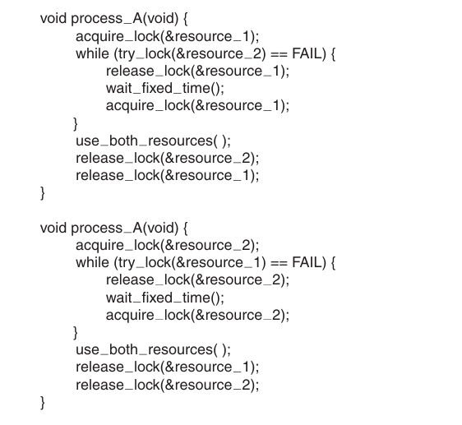

Slide 44
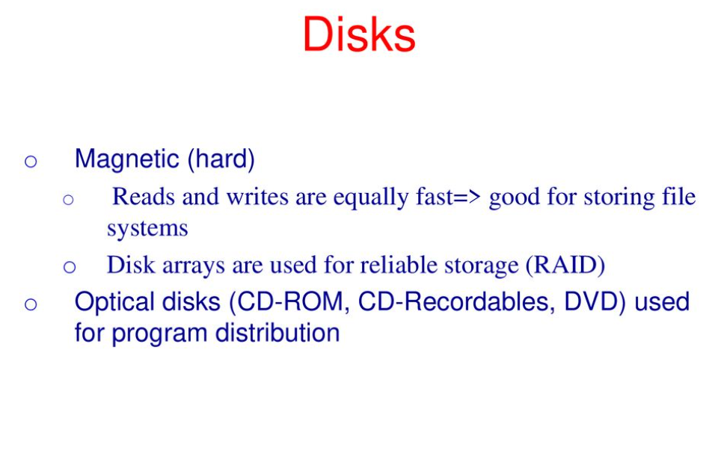

Slide 45
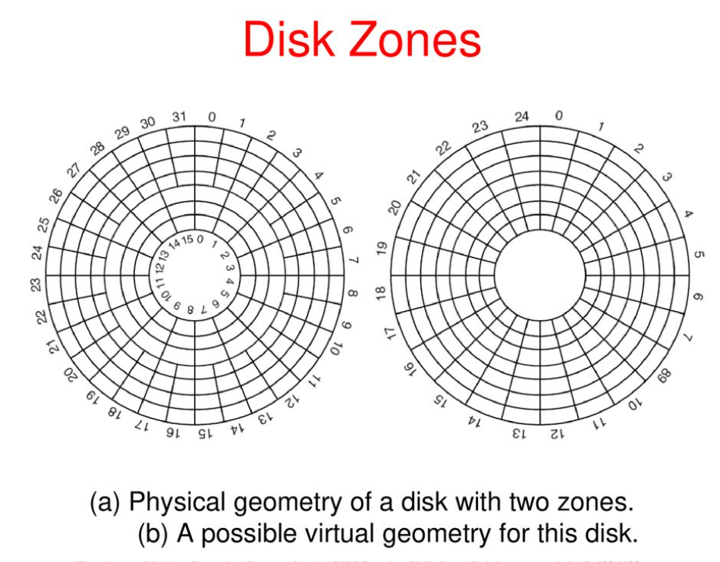

Slide 46
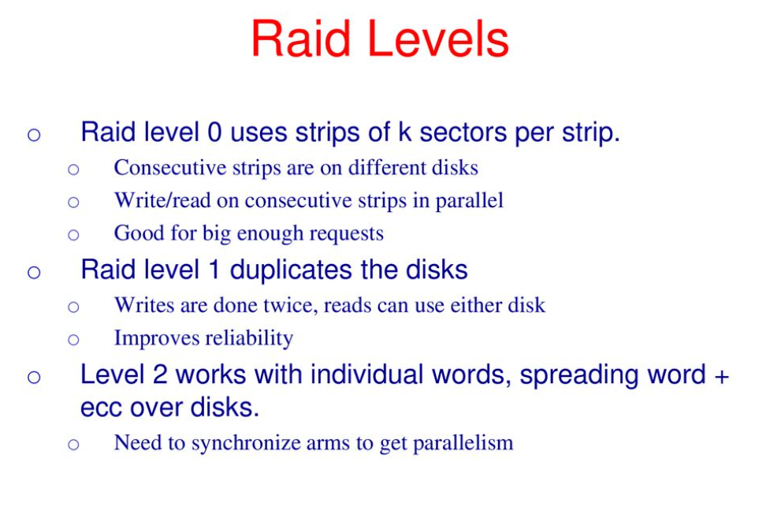
RAID

Slide 47
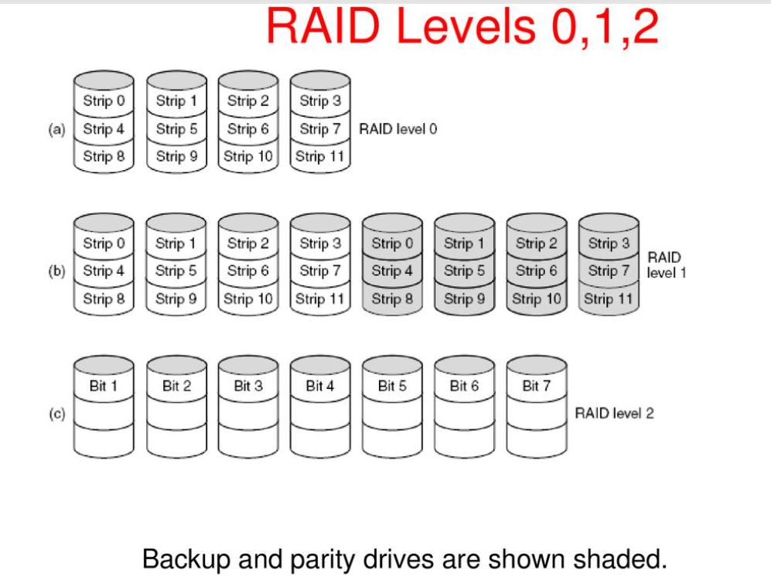

Slide 48
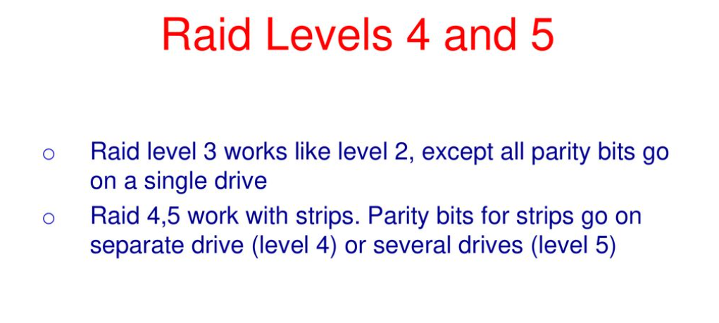

Slide 49
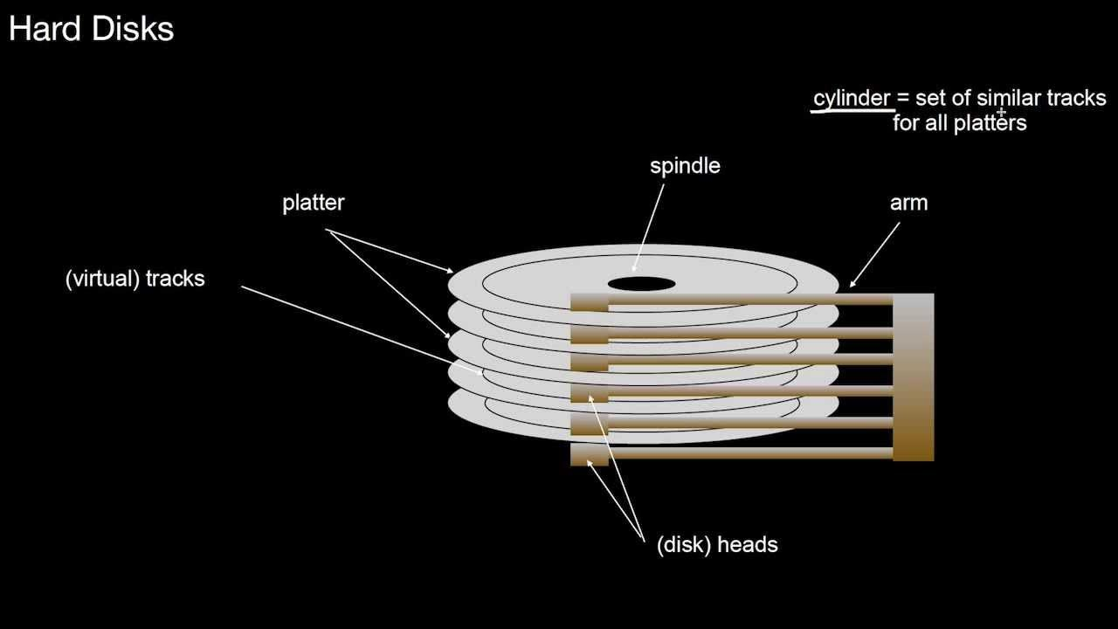
Disk Scheduling Algorithm
Used to reduce the seek time

Slide 50
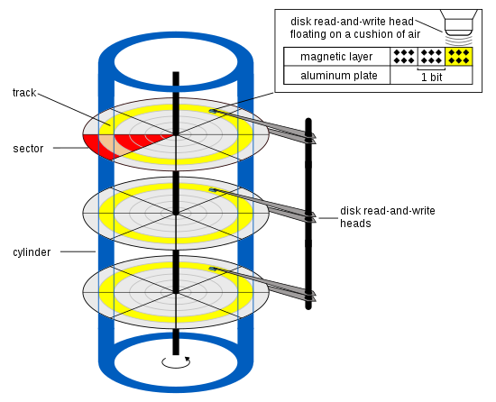


Slide 51
Platter
Surface
Track
Sector
Seek time-time taken to reach up to desired track

Slide 52
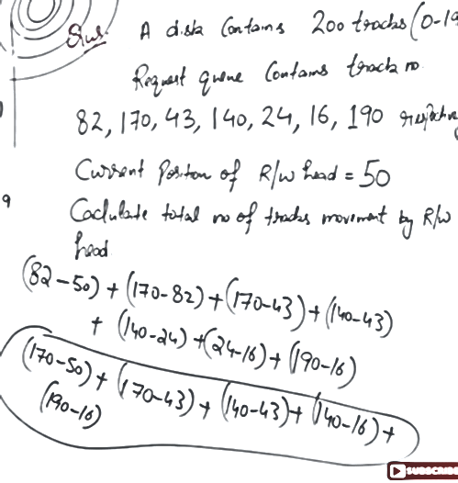
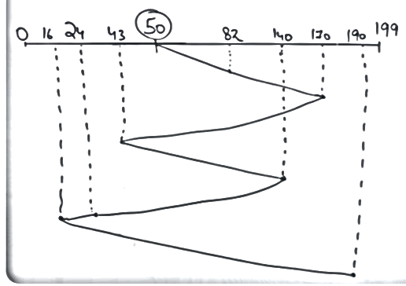
FCFS

Slide 53
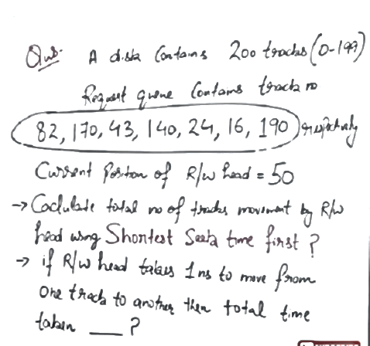
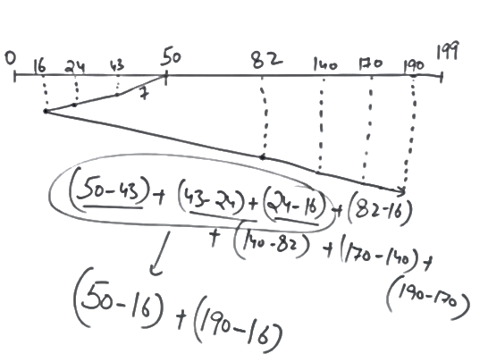
Shortest seek time

Slide 54
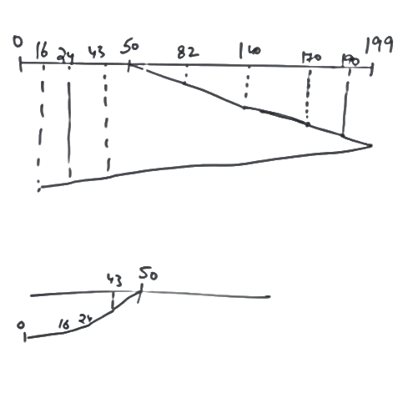
Scan / Elevator Algorithm
Moves in on direction till last
(199 in given example)
And starts mobbing opposite
direction (but no till last i.e ‘0’
in the example)
Cant serve again in opp. Direction
during dynamic request
Seek time=(199-50)+(199-16)=332

